Slide 1


Digital Innovation Platform
IBM Bluemix

Slide 2

















The rate of innovation is expediential
“Two guys in a Starbucks can have access to the same computing power as a Fortune 500 company.”
Jim Deters - Founder, Galvanize
Design Thinking
Runtimes
APIs
Micro
services
IoT
Extreme
Agile
Tooling
Containers
Notes:
The digital disruption is underway across all industries, and at the core of this disruption is a transformation and acceleration of innovation, development and delivery methods. Enterprise executives recognize the significance of this transformation and are seeking ways to bring the culture of startup innovation into their enterprise. They need to lead the digital disruption or risk being disrupted -- digitally disintermediated from their customers, employees, or suppliers. Born on the cloud startups are leading many disruptions and using new methods to achieve these disruptive innovations.
These digital disruptors are delivering new business models and customer value at high speed and high quality, continuously iterating and experimenting in-field to achieve their desired business outcomes. Pivoting and rapidly iterating to achieve customer adoption and revenue growth.
These new methods, typically discussed as DevOps, encompasses a transformation of culture, processes and tools. In a manor that accelerates innovation, rapid instantiation of new services, and data driven iterations

Slide 3
Innovation makes disruption possible.
Bluemix works
for disruptors

Slide 4





Companies of all sizes have ability to disrupt,
or face the prospect of being disrupted.
Successful business will be the ones that embrace change and innovation and transform at speed.
Deliver the right app
to the right user
at the right time
for the right experience
Notes:
Slide Intention
Start the conversation. *Talk to Uber and how it disrupted the way users view/expect transportation*
Technology shifts are driving unprecedented business transformation
The new class of innovative and disruptive companies build apps and services, they don’t run data centers
The most successful enterprises will be the ones that embrace change and innovation and transform at speed

Slide 5

New Business Value
Enterprise want to disrupt, but...
Existing
Applications

Slide 6



Enterprises need instrumented, automated coordination for two-speed IT
Bluemix enables
Possess a unique capability by leveraging existing systems
Enterprises need to find a balance between IT & Innovation.
Hybrid is a great opportunity to develop new business via digital channels.
Disruption can occur when enterprises are slow to adapt
Rapid iterations
Production
Develop
Build
Test
Deploy
API Catalog
Systems of Interaction
Digital Applications
Systems of Record
Enterprise Applications
Slower iterations
Develop
Build
Test
Deploy
Production
Enterprise have different requirements
Application monitoring and loggin
Corporate Policies
Regulations
White Labelling
LDAP Integration
Security and Privacy

Slide 7
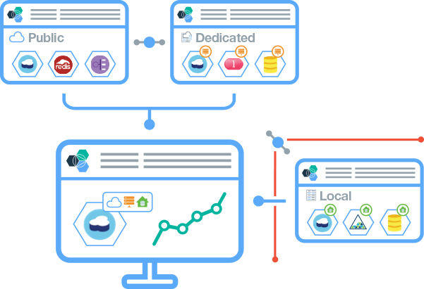

Bluemix delivers the cloud value proposition
Today, cloud is being consumed at an expotential rate. Cloud is a game changer in the way we consume and manage IT today.
Enterprises are aggressively implementing their clouds strategy, however, manageing this environment is costly and resource heavey
1
Provides an Innovation Platform that is open and non-proprietary, delivers everywhere and you can start anywhere – public, private, on-prem, off-prem
2
IBM Managed Cloud that allows developers to innovate quickly and addresses your needs for security and compliance.
3
Provide turn key delivery that allows you to get started immediately with Bluemix and grow as your needs mature.
Notes:
IBM managed platform
Bluemix is a fully managed platform offered seamlessly across public, dedicated and local deployments. Leverage IBM’s experience and expertise to provide a platform that is always current and always available.
24/7 Ops Team
Expertise gained by running the worlds largest Cloud Foundry environment supporting over 1B API calls per day
A true partnership with IBM
In addition to ensuring that your environment is always current, the IBM Global Operations team will monitor your Bluemix installation ensuring you have the responsiveness, capacity and availability required to run enterprise workloads
Priced based on usage/provisioning
Take advantage of economies of scale in the public model and enjoy the flexibility to expand and contract in private models.
Where you need it
Bluemix provides a consistent experience across the public cloud and two private models (Dedicated and Local). Start quickly and adopt a model as your workload matures. Run application workloads where you need to with the flexibility to adapt to changing market conditions and regulations

Slide 8
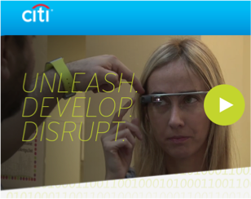
Citi Mobile Challenge Selects Bluemix
Goals:
Provide developers with a unique, global developer ecosystem.
Accelerate the mobile development of innovative financial service solutions for their customers in order to retain customer retention.
Why Bluemix?
“IBM Development tools challenged Citi into helping them turn ideas into innovative realities.
The IBM Cloud Platform and industry API’s enable developers to quickly create mobile solutions by offering new services on their mobile device like never before.”
“IBM's recognition that the Citi Mobile Challenge is fostering the development of the next generation of FinTech solutions serves as great validation of our efforts to accelerate and lead digital innovation,"
Heather Cox, Citi Chief Client Experience, Digital and Marketing Officer for Global Consumer Banking
Notes:
Any size company can drive distuprion – small or large.....even one of the largest in the world
When Citi looked to change/disrupt their business model, they went to Bluemix
“People want banking, not banks” Systems of engagement, they come to us… scale
Message: Citi is driving innovation in the financial markets. Pick 1 powerful message/slide 5-7, put others in back-up (Cross Industry)
Go to this wiki for your Geo to introduce business models that changed the game.

Slide 9

What is Bluemix?
Inspiring Innovation
Notes:
Bluemix has been a huge game changer in the way we consume and use applications – Look further at what Bluemix really is and how it can be used

Slide 10
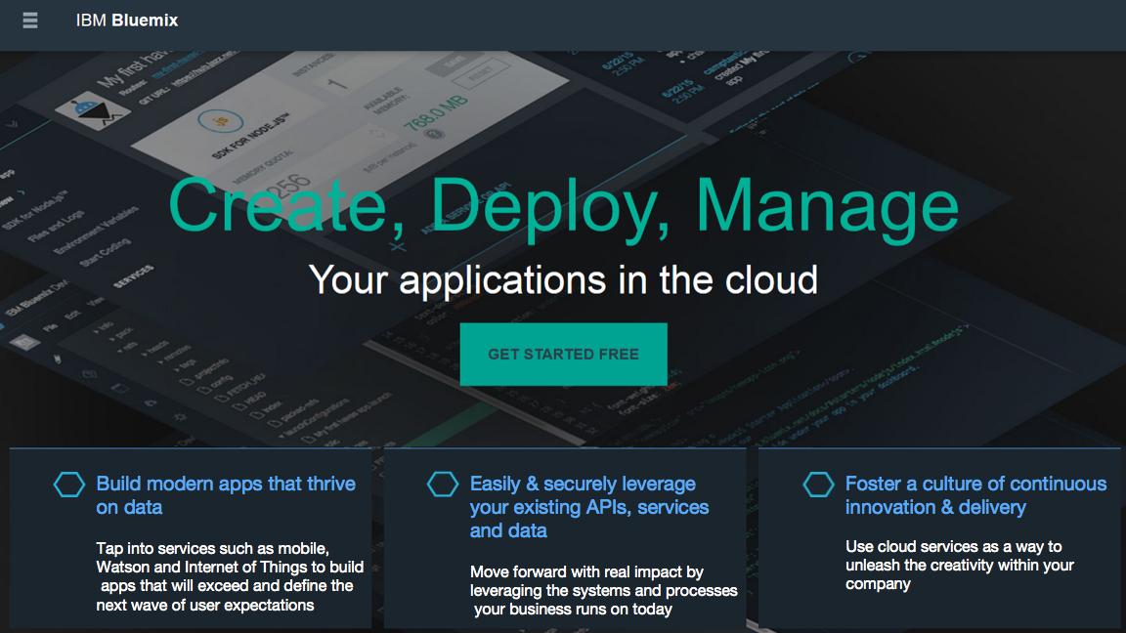

Slide 11
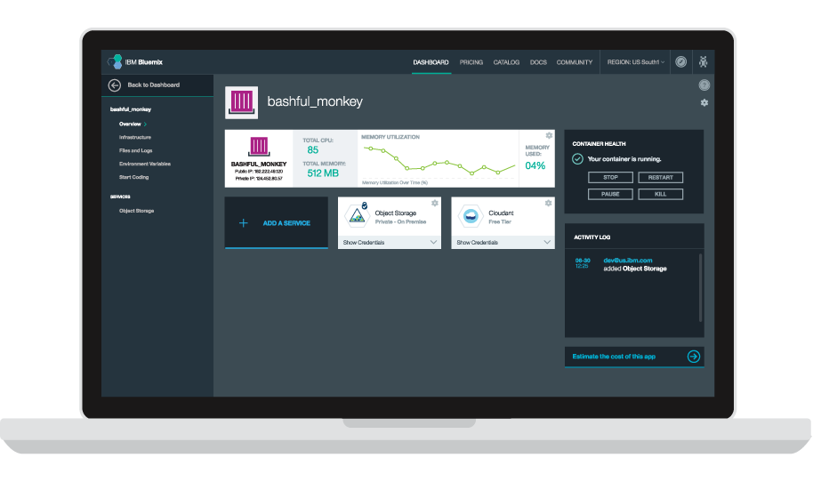





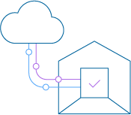
The Bluemix Platform
Core Platform
App Centric Compute
Global // Hybrid // Open
Global // Hybrid // Open
PaaS // Container // VM’s
API’s
Data Driven App’s
IBM // 3rd Party // Yours
Watson // IoT // Big Data
Easily & Securely leverage your existing API’s & Data
Build modern apps that thrive on data
Powered by Open
Built for enterprise
IaaS // PaaS // SaaS
Development // Integration // DevOps
Optimize and transform existing apps
Foster a culture of continuous innovation & delivery
Notes:
Enterprises need a cost efficient, robust and open platform to unleashes developer productivity and foster digital innovation
Bluemix is IBM's digital innovation platform that is cloud based, open, ready for hybrid, leverages existing assets, productive, modern, up to date etc.

Slide 12

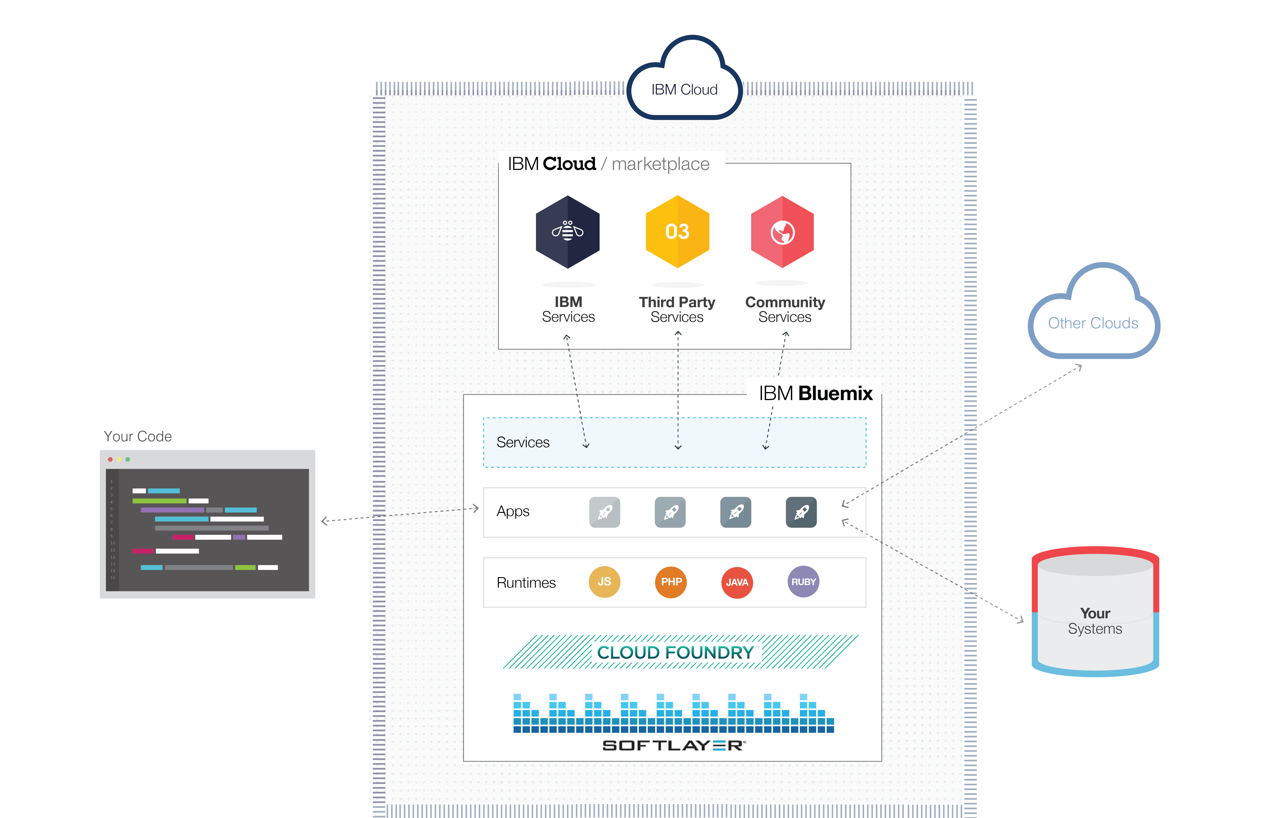









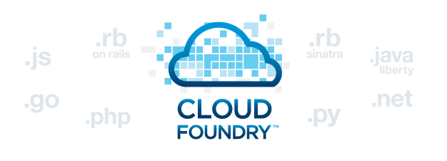




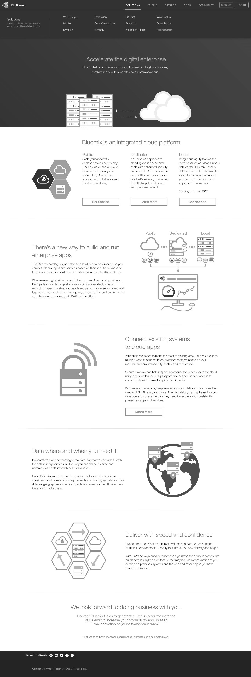
How does Bluemix work?
DevOps
Tooling
Integration & API Mgmt
Bluemix is also built on 3 key open compute technologies: Cloud Foundry, Docker, and OpenStack.
Your Own Hosted Apps / Services
Catalog of Services that Extend Apps’ Functionality
+
It extends each of these with a growing number of services, robust DevOps tooling, integration capabilities, and a seamless developer experience.
Web
Data
Mobile
Cognitive
Analytics
IoT
Security
Yours
Flexible Compute Options to Run Apps / Services
Instant Runtimes
Containers
Virtual Machines
+
+
+
Platform Deployment Options to meet Workload Requirements
+
Bluemix
Public
Bluemix
Dedicated
Bluemix
Local*
+
Powered by IBM SoftLayer
In Your Data Center
Notes:
Start at the bottom of the stack and work to the top (From Deployment models/flavors through the ability to host your own services/api’s) before going into the extendibility of using your own tool and an ‘out of the box’ API management system.
Slide transitions are built into the deck to help articulate the story

Slide 13
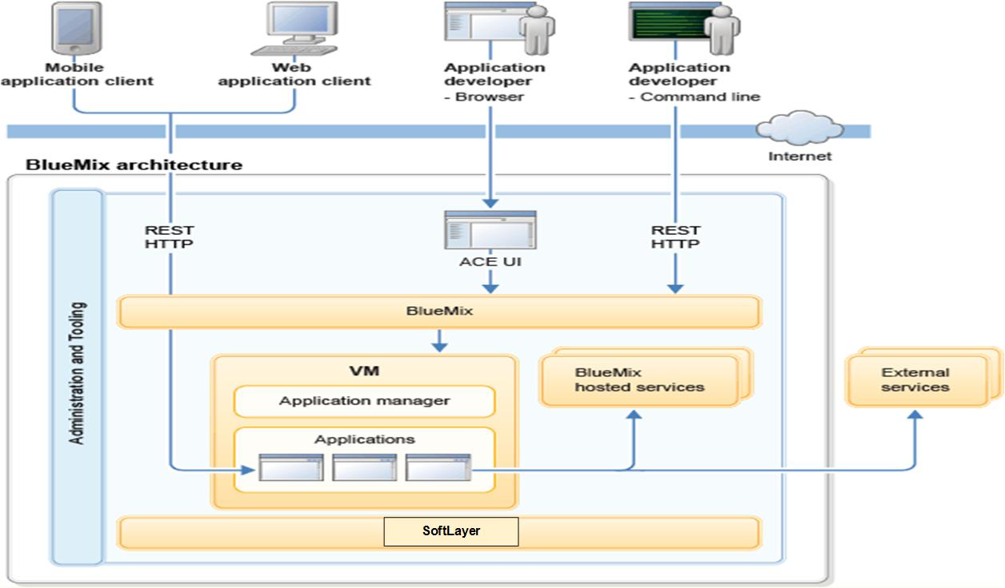
BlueMix Architecture – High Level
Notes:
At its core, BlueMix is an environment for building applications and leveraging a set of services to aid in the simple development of those applications.
BlueMix also provides an application hosting environment for hosting those application artifacts that run on a server. Leveraging SoftLayer, BlueMix deploys a set of virtual containers that host each deployed application and provides an environment where that application can leverage a set of pre-built services (including 3rd party services) to make application assembly easy.
BlueMix allows for its users to interact with the infrastructure via a browser-based user-interface (UI) called BlueMix user interface. For deploying web applications, a command line tool called cf is also available.
Clients (whether they are mobile applications or applications that run externally, applications that are built on BlueMix, or human using a browser) interacts with the BlueMix hosted applications via REST/HTTP APIs. Each request is routed through BlueMix to one of the application instances or its composite services.
When an application is deployed, the application developer needs to configure BlueMix with enough information to support the application.
For a mobile application, BlueMix contains an artifact that represents the mobile applications back-end - for example, the set of services that are used by the mobile application to communicate with a server.
For a web application, the application developer needs to ensure that BlueMix is told the proper runtime and framework so that it can set up the proper execution environment in which it attempts to run the application. Each execution environment (irrespective of mobile or web) is kept isolated from other application's execution environment even though they reside on the same physical machine.

Slide 14
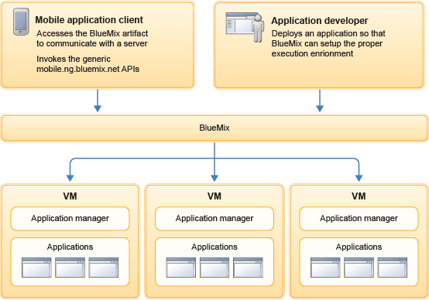
BlueMix Architecture – How it works
Notes:
When an application is deployed, the application developer needs to configure BlueMix with enough information to support the application.
For a mobile application, BlueMix contains an artifact that represents the mobile applications back-end - for example, the set of services that are used by the mobile application to communicate with a server.
For a web application, the application developer needs to ensure that BlueMix is told the proper runtime and framework so that it can set up the proper execution environment in which it attempts to run the application. Each execution environment (irrespective of mobile or web) is kept isolated from other application's execution environment even though they reside on the same physical machine.

Slide 15
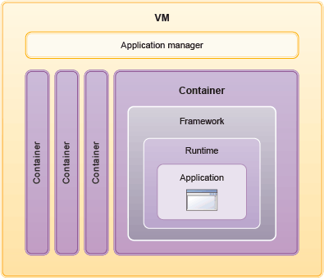
BlueMix Architecture – How it works
Notes:
As the developer creates an application (and deploys it to BlueMix), the BlueMix environment determines an appropriate virtual machine (VM) to which the application (or artifacts that are represented by the application) will be sent. F
or a mobile application, a mobile back-end projection is created on BlueMix (for which any CloudCode - code that runs on the cloud by the mobile application developer) will eventually run in. For of a web application, it will be the application that the developer deploys (pushes) to BlueMix.
This determination is based on several factors - including load already on the machine and runtimes/frameworks supported by that VM. Once a VM is chosen, an application manager on each VM will then install the proper framework and runtime for the application. Then, if necessary, the application will be deployed into that framework. When completed the application artifacts are then started.
While the previous description talks about running an application, and implies there is only one instance of it, the exact same flow happens when the application developers want to have multiple instances that are running. In those cases, while the application is uploaded only once, BlueMix deploys as many instances of the application as requested, across as many VMs as needed. Whether instances of the same application are on the same or different VMs vary based on load of the VMs. However, the application developer is unaware of these choices.
Within each VM, there will be an application manager whose job is to communicate with the rest of the BlueMix infrastructure as well as to manage the various applications that are deployed into this VM. Within each VM, there will be a set of containers.
And finally, within each container BlueMix will install the appropriate framework and runtime that is needed for each application.
Once the application is deployed, if it has a web interface (such as a Java webapp), or other REST-based services (such as mobile services exposed publicly to the mobile application), users of that application will be able to talk to it via normal HTTP requests
Each application can have one, or more, URLs associated with it but all of them must point to the BlueMix endpoint. As each request comes in, BlueMix will examine the request, determine which application is it intended for and then pick one of the instances of that application to receive the request.
BlueMix is designed to host scalable applications (and application artifacts). This means that instances of your application might need to be created or deleted as the load of your application changes.
Therefore, any instance of your application (even in the case where you have one instance only) might be terminated, delete, moved, or re-created on a new VM/container at any time as needed. For this reason, your application saves all persistent data in a datastore that is outside of your application - for example, on one of the datastore services that are provided by BlueMix. Any data is stored local to your application (that is, in memory or on local disk) will disappear when that instance of your application disappears.

Slide 16
Compute flexibility
Devs get to choose the level of infrastructure abstraction and fine-tuned control that suits their apps and services.
Instant Runtimes
Containers
Virtual Machines
The highest level of infrastructure abstraction. Focus on the app.
Powerful, but less resource intensive than VMs. Key to supporting hybrid portability.
Control all the way down to the operating system.
What’s different about Bluemix?
Docker as-a-service means no VMs to manage
A repository of enterprise-grade images which are trusted and secure
Enhanced performance and scalability
Integrated monitoring, logging, networking, and storage
Extends Cloud Foundry with DevOps tooling, integration capabilities, and seamless app management
Support for 7 key languages and the option to use a community buildpack.
Deploy and manage VMs consistently across public, dedicated, and private instances with a single dashboard.
Connect to your own OpenStack infrastructure

Slide 17
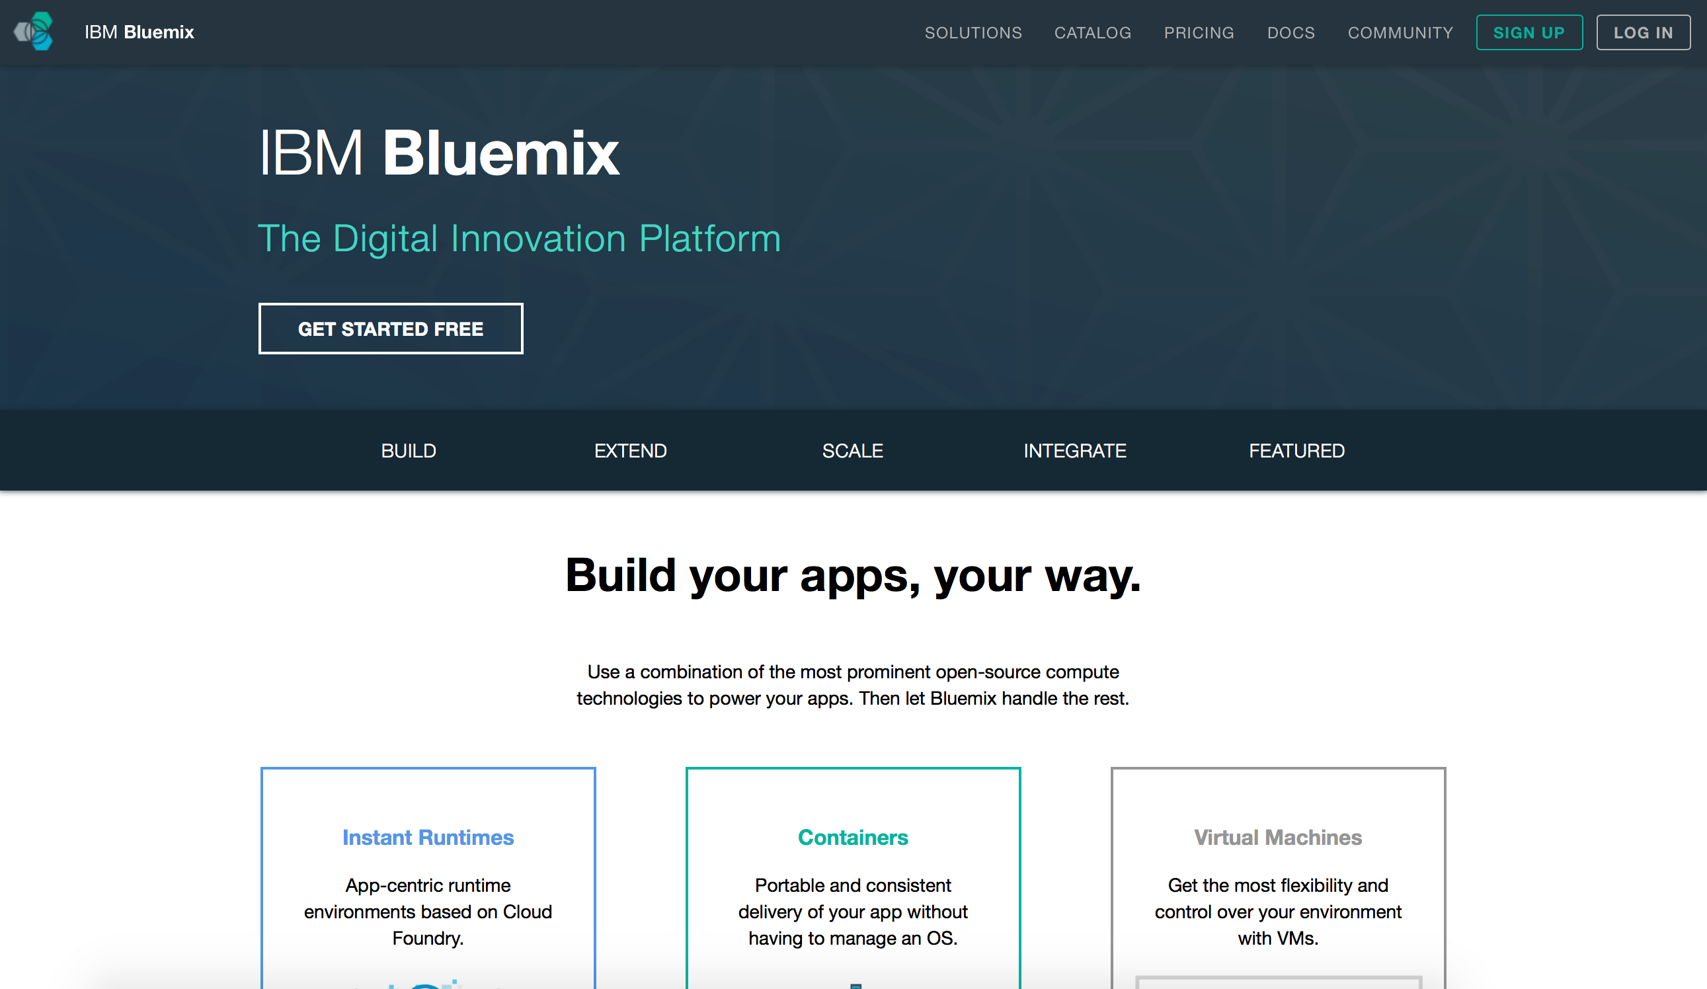
Let’s see it!
*click*
Notes:
Link to a page with 3 demo’s
1Minute Demo

Slide 18


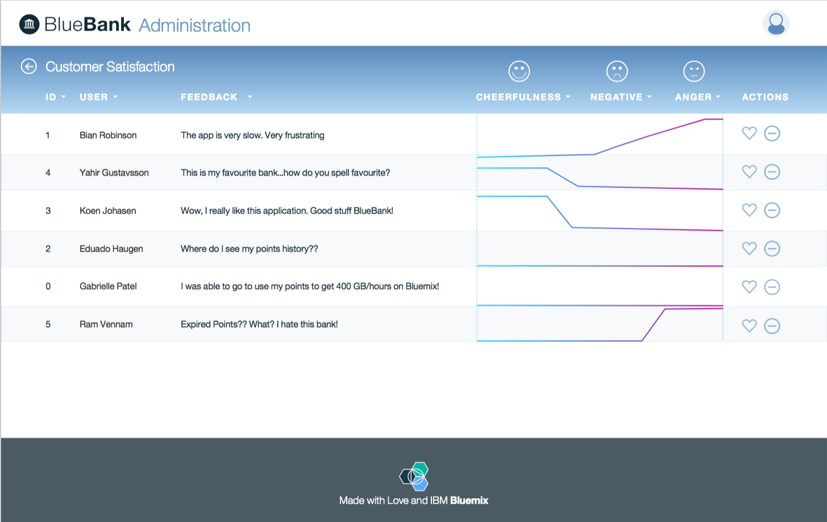









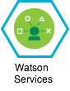

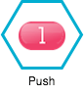
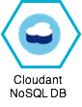
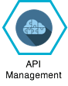
Hybrid Customer Example
Customer Loyalty App
BlueBank Internal
Application
Public
Local
Syndicated
Live Demo: https://www.youtube.com/watch?v=eLX05QkZ-s0
Notes:
Ram’s Demo – Message (use case)
Live Demo: https://www.youtube.com/watch?v=eLX05QkZ-s0 - PLEASE REMOVE BEFORE SHARING
This slide should lead back to openness of Bluemix (moving workloads, services and API’s………leading to choice of Compute, tooling and deployment models)

Slide 19













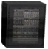



































As a result, hybrid Cloud Applications are becoming the norm for the Integrated Digital Enterprise …
Public Cloud
Dedicated Cloud
Private Cloud
DMZ
Enterprise
DMZ
Social & Internet Data sources
Mobile, PoS, ATMs
APP
Service
APP
APP
DB
Service
APP
DB
APP
DB
Internet
Internet
API
API
Internet of Things
Sensors
Developer & Customer communities
Trading partner communities
Master Data Management
Big Data
Notes:
19
define APIs that you want to expose outside
add mobile access to your env. i.e. create mobile apps that access your enterprise and provide service.
add bigdata, analytics and take advantage of social media. Also IOT
trading partner communities and customer communites to gain access to your enterprise function through APIs. Think bestbuy api and googlemap api

Slide 20
Innovation makes disruption possible.
Bluemix deployment
for everyone,…..everywhere

Slide 21





Bluemix – Public Cloud
Bluemix is a multi-tenancy open-standards, cloud-based platform for building, running, and managing applications.
Build your apps, your way
Use the most prominent compute technologies to power your app: Cloud Foundry, Docker, OpenStack.
Deploy and manage hybrid apps seamlessly
Get a seamless dev and management experience across a number of hybrid implementations options.
Scale more than just instances
Development, monitoring, deployment, and logging tools allow the developer to run and manage the entire application.
Layered Security
IBM secures the platform and infrastructure and provides you with the tools to secure your apps.
Flexible Pricing
Try compute options and services for free and, when you’re ready, pay only for what you use. Pay as you go and subscription models offer choice and flexibility.
Extend apps with services
A catalog of IBM, third party, and open source services allow the developer to stitch an application together quickly.
Coming Summer 2015

Slide 22



Bluemix – Private Cloud
Bluemix Private Cloud is a single-tenancy open-standards, cloud-based platform for building, running, and managing applications, available as Dedicated or Local
Bluemix Dedicated
Bluemix Local
Dedicatd to you
A single tenancy envoirnment that is dedicated to you – allowing you to satisfy regulatory and legal compliance
Deployment Choice
Bluemix Local runs on either VMWare or OpenStack driven infrastructure.
*OpenStack coming soon
•
Focus on App’s – Not Iron
Focus on building customer applications and services. IBM manages the platform and your dedicated service
•
Portable Apps & Services
Move workloads as performance requirements or regulation change
•
Global Locations
Bringing you closer to your user with dedicated living in any SoftLayer data center around the globe
•
We’re on call – 24/7
Experts are always on hand to solve your problems. Premium support options are available to meet your requirements
22

Slide 23
Bluemix offers choice. What is the difference between the offerings?
 | Public | Dedicated | Local
Tenancy | Multi | Single | Single
Payments | Pay-Go & Subscription | Subscription | Subscription
Infrastructure | IBM Provided | IBM Provided | Customer Provided
Provisioning | Instant | 2 weeks* | Customer Dependent
IaaS | Softlayer | Softlayer | Openstack or VMWare
Softlayer | Dallas & London | Any Location | NA
Catalog | Public | Syndicated | Syndicated
*Typically limited by customer network and security configuration
Notes:
Bluemix is built on top of IBM’s infrastructure as a service offering - SoftLayer. It embraces Cloud Foundry as an open source platform as a service and extends it with IBM, third party, and community built services.
Explain Diagram (verbs in blue - please use this terminology)
Start by Pushing your code through Cloud Foundry
Cloud Foundry interprets which language you’ve used and associates your code to the appropriate runtime - now you have a working app (layer above runtimes).
Your app can
Pull prebuilt services (IBM, 3rd party, or community built) in from the marketplace and utilize their functionality
Connect to traditional IT - aka “Your Systems” with a secure connector
Connect to other clouds that you utilize with a secure connector
All of this sits on infrastructure (networking, storage, servers) hosted by IBM Softlayer (IBM’s IaaS cloud offering)
Finally - when your app is built and ready to go, it can be accessed by anything with a web browser and a connection to the internet, a smartphone app (via the Bluemix SDK) to utilize backend services, or another type of app or system (via an API you create).

Slide 24



Relay – our secure remote management
What is Relay?
Providing enterprises with an on-premises cloud that is current, healthy and available
Installation & initial setup
Get up and running, behind your firewall,
Protected and audited access
IBM never has access to your applications or data.
Platform Monitoring
IBM provides continuous health check monitoring for 24/7 support
Leverages Extensive Testing in Public
Take advantage of testing & validation from Bluemix Public
The differentiator
Keeps your local environment identical to the public and dedicated platform
Lets you absorb new technology and innovation faster than ever before.
Notes:
First of its kind delivery mechanism

Slide 25
Who manages what
Area | IBM Responsibility | Customer Responsibility
Platform Management | Manage the Platform layer Platform Installation and Configuration Manage Updates and Security Fixes Help Customer Manage Capacity Install additional Services/Features Backup and Restore | Manage the IaaS layer Manage select Platform capabilities via the Administration Console Manage Catalog (add/remove services and runtimes for their orgs) Monitor Environment
User Management |  | Manage Users via LDAP
Platform Updates | Ensure highest quality experience by fully testing new features, updates and fixes and validate in Bluemix Public Publish updates within 3 weeks | For non-critical updates, customers select a day within a 21 day window for the update to be applied If the customer does not select a date, the update will be applied at the end of the window
Security | Monitor Platform Security Identify and fix vulnerabilities Clear Communication with Customer | Review security and audit logs Manage Firewalls and IaaS security
Capacity Management | Provide usage reports and projections Provision or de-provision capacity at the Platform level based on customer requests | Track usage and project future growth Manage IaaS Capacity
Problem Resolution | Proactive Monitoring, Troubleshooting and Problem resolution of PaaS and IBM provided services | Proactive Monitoring, Troubleshooting and Problem resolution of IaaS, Networking, and customer services and applications

Slide 26
Innovation makes disruption possible.
Bluemix services
for everyone,…..everywhere

Slide 27
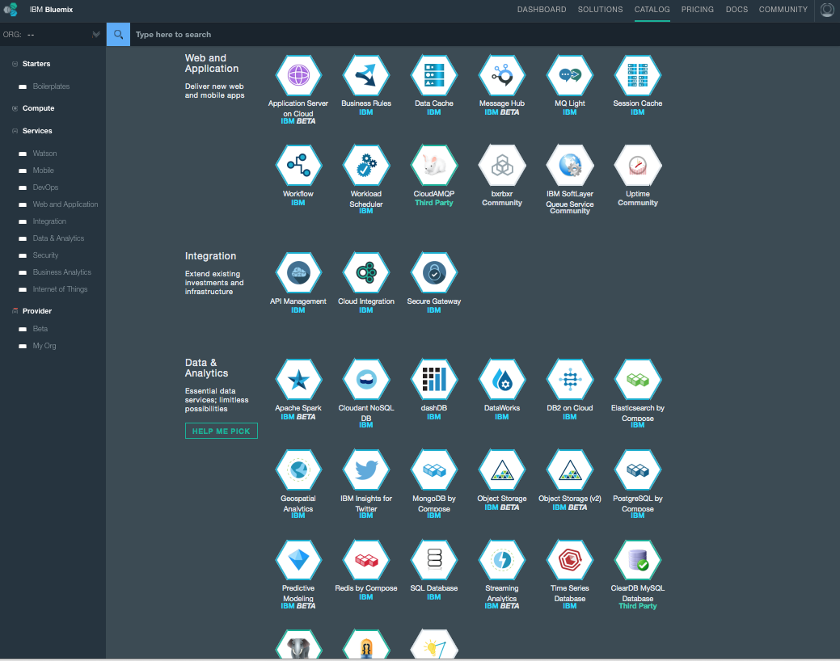

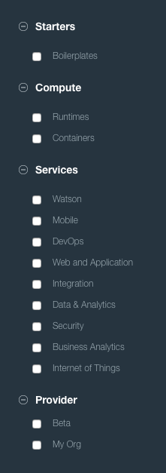




Broad range of IBM & 3rd Party Services
Commerce
Healthcare
Analytics
Watson
Security

Slide 28



Watson on Bluemix
Watson is creating a new partnership between people and computers that enhances, scales and accelerates human expertise
Reason
Listening
Speech
Learning
Vision
IBM Watson services available on Bluemix are the building blocks for developers to create the next generation of cognitive applications to transform the way businesses engage with their customers, discover, innovate and make decisions
…build with Watson
Notes:
Watson is ushering in a new era of computing; it is fundamentally different from the conventional, programmable computing systems that we’re used to.
Watson mirrors the same cognitive process that we use every day to understand the world around us.
With its ability to learn and navigate the language and protocols of specific professions and industries, and communicate in natural language, Watson is revolutionizing the way we make decisions, become experts and share expertise, at scale.

Slide 29
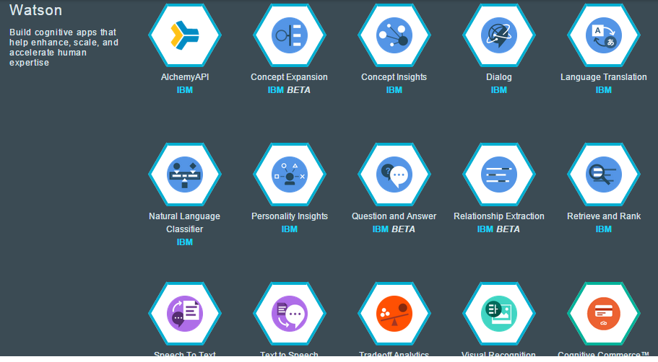
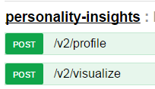
Watson on Bluemix – Open API’s
Application can consume the Watson services through its API’s
http://www.ibm.com/smarterplanet/us/en/ibmwatson/developercloud/apis/
Reason
Listening
Speech
Learning
Vision
Notes:
Watson is ushering in a new era of computing; it is fundamentally different from the conventional, programmable computing systems that we’re used to.
Watson mirrors the same cognitive process that we use every day to understand the world around us.
With its ability to learn and navigate the language and protocols of specific professions and industries, and communicate in natural language, Watson is revolutionizing the way we make decisions, become experts and share expertise, at scale.

Slide 30


IBM Mobile Services
Core services that just about every App needs
StrongLoop Arc
Enterprise Node.js to build, deploy, scale manage and deploy your mobile APIs
Core App &
Platform Services
Push
Increase User Engagement with Mobile Push Notifications
Cloudant
The Ultimate Data Store for Mobile Apps
Mobile Client Access
Simplified Mobile App User Authentication
Capabilities to manage the lifecycle of your Apps
Mobile App Server
Manage, secure, and optimize enterprise mobile apps
App Lifecycle
Services
AppScan Mobile Analyzer
Identify Mobile App Security Exposures
Mobile Quality Assurance
Continuously Improve Mobile User Experience
Capabilities to enable apps to make users more productive based on context
Mobile Content Manager
Create, manage, and deliver more relevant in-app content
Presence Insights
Enables Apps with Intelligent Mobile Location Data
Contextual
Services
Notes:
Mobile

Slide 31
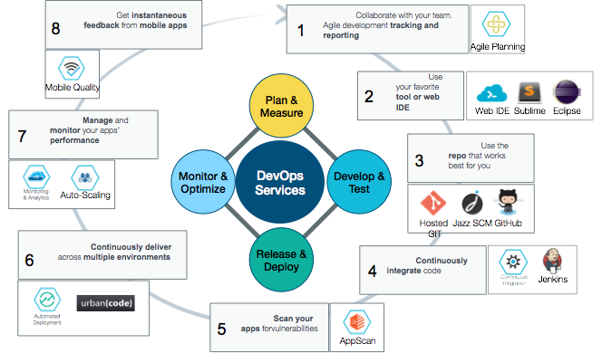
Continuous Innovation & Delivery
Fit for an enterprise, the DevOps experience is unified and open across compute technologies, Bluemix delivery methods, and integrated systems.

Slide 32

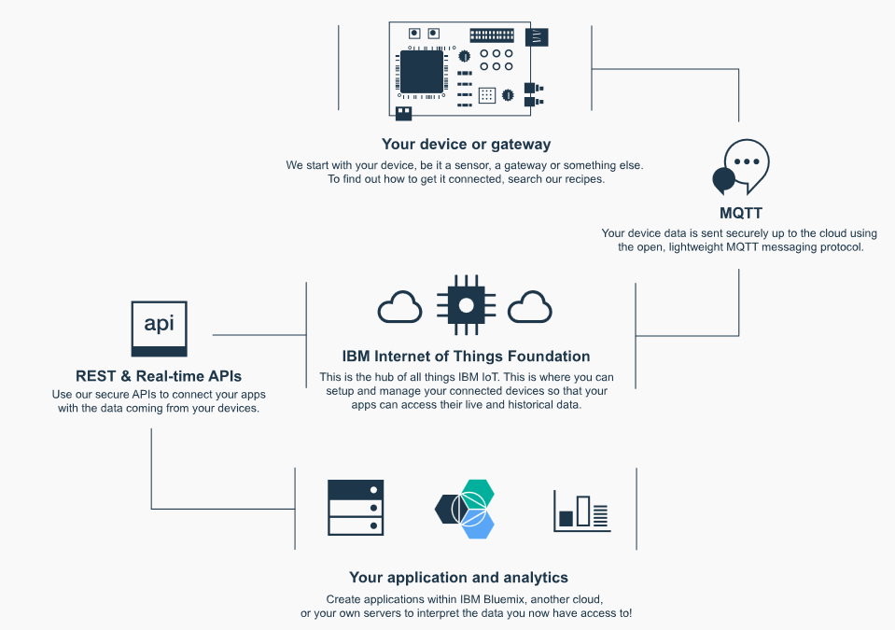

Turn new data into new value with IoT
Internet of Things Foundation
Set up and manage your connected devices so all your app’s can access the data
Notes:
IoT

Slide 33








New Patterns of Integration
Hybrid Integration
The Need
The Service
Secure
Gateway &
Connectors
IT
Connect
Securely connecting Bluemix to your local cloud
Data Analyst
Shaping your data for use by mobile and analytics
DataWorks
Refine
Delivering your data closer to your users
DataWorks
Data Analyst
Deliver
Rapidly compose and mix APIs into new apps
Connect &
Compose
Compose
App Developer
Exposing APIs and Data sets into the API Economy
API
Management
Expose

Slide 34
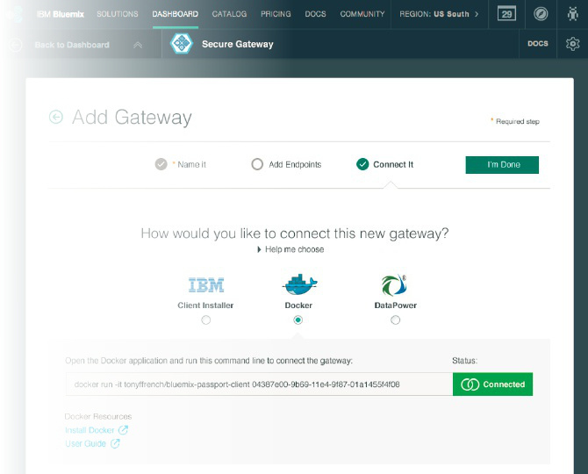

Connect Clouds Securely Together
Secure Gateway - creating a hybrid connection to on-premises data
Connect
IBM Secure Gateway: Provides secure connectivity from Bluemix to other applications and data sources running on-premise or in other clouds.
What’s unique?
Unique passport feature allows for single step download, install, and secure setup of client
Flexible Gateway topology allows segregation, Load Balancing, Fault tolerance
Layered security on the cloud side and client side
API / SDK for secure connect directly from app
Notes:
Intergration

Slide 35
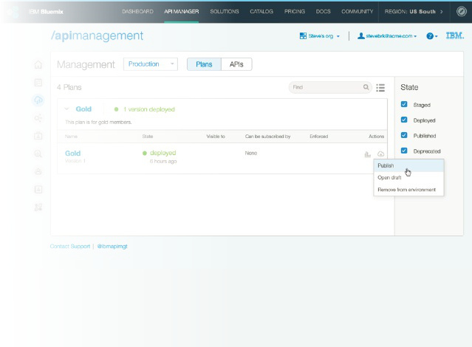
Expose APIs and Data
API Management to publish an API to Bluemix for developers to use as a service
Expose
IBM API Management: Enterprise API Management experience for all of your Bluemix APIs. Discover APIs from on-premises resources. Secure, layer policy, publish, and manage your APIs.
What’s unique?
Externalize an API from Bluemix to allow secure, governed, monitored usage of your app
Discover and load APIs to Bluemix from on premise sources like z/OS Connect and an ESB
Enable partners to innovate on your APIs by publishing into their Bluemix orgs via safe opt-in process
Notes:
Integration

Slide 36
Innovation makes disruption possible.
Bluemix openness
sets your innovation free

Slide 37










More openness and choice than ever before
Bluemix avoids vendor lock in. You choose how you build, deploy, and manage your apps. Bluemix make in infrastructure available.
Compute
Dev Tooling
Choose the level of infrastructure abstraction based on your app’s architectural needs.
From editors to source code management to continuous delivery, you can use Bluemix’ powerful tooling or easily bring your own.
Location
Services
Deploy apps to Bluemix Public (in a growing number of geos), your own dedicated cloud Bluemix, or one that runs within your data center (Local*).
Pick from a catalog of IBM, third party, open source, or your own services to extend your apps.
IBM
Third Party
Open Source
Yours
Notes:
Bluemix also allows flexibility when it comes to tooling - as, again, each developer has different preferences and needs.
Tooling Options:
IBM offers a web based integrated development environment (IDE) and associated git repository that allows quick deployments back to bluemix.
Developers can also edit code on their local machines (with the editor of their choice - i.e. Sublime) and deploy back to Bluemix through the cloud foundry command line.
Note to presenter: Other IDEs (like Eclipse, Cloud9) have direct integration with Cloud Foundry and can push code directly to bluemix, rather than a manual push by developer via command line. You may be asked about this.

Slide 38













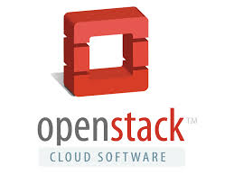







IBM Cloud is Open By Design
Open technology lynchpins maximize the effectiveness of Cloud investments
OAuth
SaaS
PaaS
IaaS
Private Cloud
Hybrid Cloud
Off-premise cloud

Slide 39
Innovation makes disruption possible.
Bluemix works
for everyone

Slide 40


Computer Services
Kiwi Wearables – Improves motion-sensing technology development with the IBM Bluemix platform
75% decrease
in proof of concept (POC) development and release times
Offers scalability and choice
with IBM, open source and third-party tools available through the IBM® Bluemix™ catalog
The transformation: “Kiwi Wearables sought to design and deliver its motion-sensing technology solutions faster and with expanded capabilities. With the IBM Bluemix platform’s cloud-based environment and enhanced capabilities, Kiwi reduced its proof of concept (POC) times and can now connect large numbers of disparate devices.”
Saves licensing expenses
with pay-as-you-use applications, application programming interfaces and software development kits
“Bluemix allowed us to get a basic prototype running in just a few days versus months.”
—Ali Nawab, chief executive officer, Kiwi Wearables
Solution components
IBM® Bluemix™
Cloudant™
Node.js
Twilio
GMP14055-USEN-00
Notes:
40
Client name:
Kiwi Wearables
Case study link:
http://www.ibm.com/common/ssi/cgi-bin/ssialias?subtype=AB&infotype=PM&appname=SWGE_GM_LT_USEN&htmlfid=GMC14042USEN&attachment=GMC14042USEN.PDF
Quote:
IBM quickly solved some of the challenges Kiwi Wearables faced. Ali Nawab, chief executive officer (CEO) at Kiwi says, “Instead of having the burden of trying to connect with the 300 to 400 different cloud-reliant devices on the market, we sped up the process with IBM Bluemix, which allowed us to get a basic prototype running in just a few days versus months.”
Company background:
“Kiwi is focused on solving problems for companies that are in the wearable tech industries. We’ve been spending all of our time and energy making motion-sensor technology as easy as possible so that a wider audience can bring motion into whatever products and applications they are building,” says Ali Nawab, chief executive officer (CEO) at Kiwi Wearables.
Solution components:
IBM® Bluemix™
Cloudant™
Node.js
Twilio
Business challenge:
Kiwi was comfortable and successful using proof of concept (POC), development and deployment processes it created in-house. In fact, IBM learned of Kiwi’s advances in motion detection sensor technology and approached the organization to collaborate in an IBM client project. At the time, this small company was not aware of the cost-effective, cloud-based IBM DevOps capabilities available to businesses of all sizes, but it was interested in speeding and improving its processes.
Benefits:
For Kiwi, the Bluemix platform easily integrates with mobile and cloud-based endpoints while avoiding communication complications between disparate technologies. Kiwi reduced its POC times by 75 percent, from months to days, freeing programmers to quickly transition to the next creative effort. The solution’s pay-as-you-use availability helps Kiwi avoid expensive licensing fees and time-consuming application integration tasks. And by including its own development kit in the Bluemix catalog, Kiwi can now reach buyers within the wearable technology industry, opening new global marketing channels.

Slide 41

IBM Software – Cloud
Computer Services
Jibes - uses IBM Bluemix to speed analytics time-to-insight by up to 75 percent
Up to 75% reduction
in time to insight
30% anticipated increase
in revenue
The transformation: Previously, when Jibes sold an analytics project, it had to deploy software on the client’s premises. Clients balked at the upfront investment, wanting first to see a proof of concept. Now, Jibes taps into the cloud-based IBM Bluemix and IBM DataWorks, to build and test an app with the client, making selling the Jibes solution much easier.
Minimal investment
to test analytics strategies
Solution components
"The customer discovers the value on their own … Wins will be easier."
—Ivo-Paul Tummers, CEO, Jibes
Software
• IBM® Bluemix™
• IBM DataWorks™
KUP12380-USEN-00
Notes:
41
Client Name:
Jibes
Case study Link:
http://www.ibm.com/common/ssi/cgi-bin/ssialias?subtype=AB&infotype=PM&appname=SWGE_KU_KU_USEN&htmlfid=KUC12364USEN&attachment=KUC12364USEN.PDF
Pull Quote:
“The customer discovers the value on their own … Wins will be easier.”
—Ivo-Paul Tummers, CEO, Jibes
Company Background:
Every company has data—more of it than ever. How can that data be turned into insights about customers that increase revenue? That’s a challenge faced by Ivo-Paul Tummers, CEO of Jibes, an IBM Business Partner based in the Netherlands. “We work with retail, financial, and manufacturing companies to manage data and maximize its use as a strategic asset,” Tummers says. Now he has a faster way to win new clients and guide them to greater value.
Solution components:
Software
IBM® Bluemix™
IBM DataWorks™
Business challenge:
Jibes wanted a fast way to show clients the value of predictive analytics, while minimizing upfront investments and time to value.
The benefit:
Clients can test analytics strategies with minimal investment, gain more control and reduce time to insight by up to 75 percent, from days to hours; Jibes anticipates a 30 percent increase in revenue.

Slide 42


Financial services
Nordea Bank – kickstarts a new ecosystem for innovation with a 48-hour hackathon on IBM Bluemix
48 hours
to design, develop, and deploy new applications on IBM Bluemix
Dozens of teams
over 140 people from start-ups and developers in Stockholm and Helsinki
The transformation: As FinTech start-ups continue to disrupt the banking value chain with consumer focused digital apps and services, Nordea knew that it needed to tap into this disruption. With the Innovation Challenge organized with IBM, they were able to attract Nordic start–ups and local developers to create brand new banking apps on IBM Bluemix in just 48 hours.
Design focus
with an emphasis on an exceptional customer banking experience
“The Bluemix platform served as a great enabler when running the Nordea Innovation Challenge, it supported the entire development lifecycle in an easy to understand way.”
–Carl Risberg, Head of Architecture & Technology, Nordea Bank
Solution component
IBM® Bluemix™
SoftLayer®
IBM API Management
Notes:
42
Client name:
Nordea Bank
Event link:
http://nordeainnovationchallenge.com/
Event video:
https://www.youtube.com/watch?v=kfkInW_GWjE
Quote:
““The Bluemix platform served as a great enabler when running the Nordea Innovation Challenge, it supported the entire development lifecycle in an easy to understand way.”
–Carl Risberg, Head of Architecture & Technology, Nordea Bank
Company background:
Nordea Bank AB, commonly referred to as Nordea, is a Nordic-based financial services group operating in Northern Europe.
Solution components:
IBM® Bluemix™
SoftLayer®
IBM API Management
Business challenge:
As FinTech start-ups continue to disrupt the banking value chain with consumer focused digital apps and services, the traditional relationship between the bank and customer loses relevancy. In order to tap into the latest innovations and bring the culture of disruption into their own company, Nordea Bank worked with IBM to host a two-day Innovation Challenge hackathon, which would bring in start-ups and local developers from Stockholm and Helsinki to build apps on IBM Bluemix.
Benefits:
The Innovation Challenge brought local start-ups and developers into Nordea’s ecosystem and produced a whole set of new apps on IBM Bluemix, created in just 48 hours by the teams. Not only did it allow Nordea to tap into this community, but it also provided them with fresh ideas for disruptive banking applications that they may implement in some form into their own company. The Innovation Challenge was such a success that Nordea are launching one of the entries to production and hope to conduct similar events in the future, and even expand them globally.

Slide 43
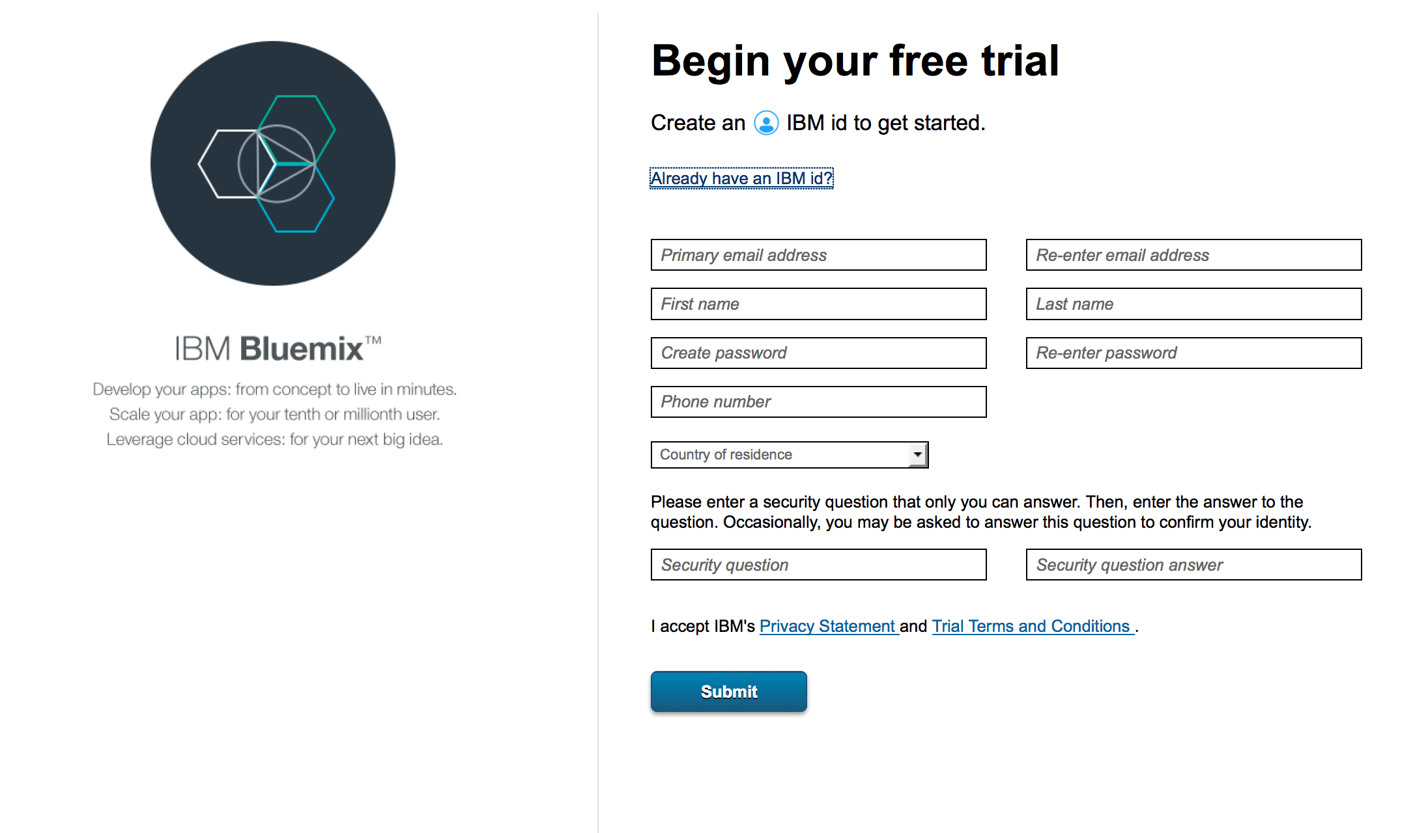
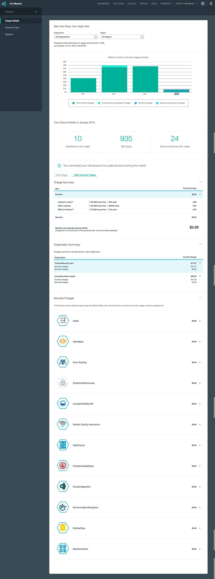
How do I get started? Sign up in minutes. Pay for what you use.
Friction free adoption
30 day trial (no credit card required) - Designed to allow testing of an entire application on the platform
Free tier for every service - encourages experimentation of new services for applications already running on Bluemix
Multiple Commitment Models
Pay-as-you-go - optimized for flexibility, no term commitment
Subscription - term based optimized for cost, discounted from pay as you go rates
Self Service
Zero to coding in less than 5 minutes
Credit card over the web in many countries - or through your IBM rep
Notes:
Bluemix’ pricing is just as flexible as many of the other capabilities we’ve discussed.
You can sign up for Bluemix in a matter of minutes
A 30 day free trial (no credit card required) allows you to experience all that Bluemix has to offer
A free tier for every service encourages further experimentation after the trial has ended
Once you’re ready to move forward with Bluemix, pricing is straightforward:
Pay as you go
Pay for what you use (runtimes/services) and nothing more
No commitment
Subscription
Pick a monthly commitment price and subscription term — receive a discount off of pay as you go rates

Slide 44
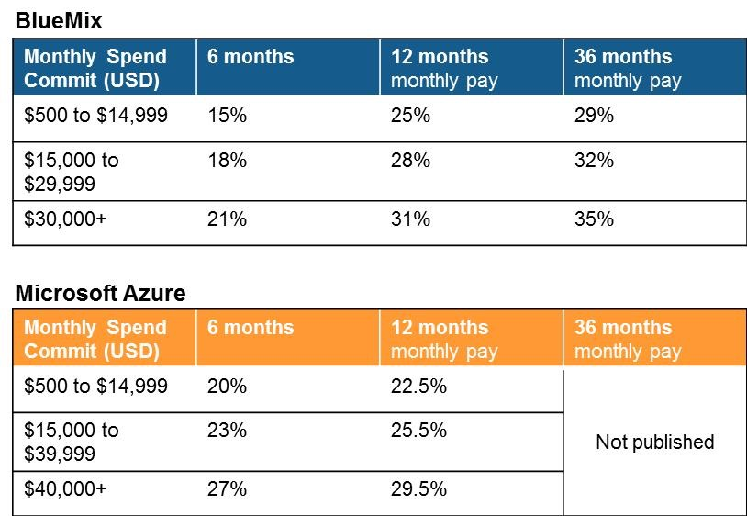
Public Pricing Structure
Pay as you go
Use case: Uncertainty around capacity or longevity of the application
User pays for usage of service metrics in excess of the free tier
Billed monthly and available via credit card only
List rates and no discounting is applied: value captured by no commitment and customer flexibility
Subscription
Use case: Heavy use, more predictable workload and multiple concurrent applications per account
User commits to spend level per period of time for discounts over pay as you go rates on the platform
Overages charged at pay as you go rates
Discounting (2x2 matrix)
Duration - 6, 12 and 36 month increments. Automatic and inside sales renewal
Spend on the platform
Co term will be allowed in order for a customer to increase their spend
Future Considerations
A subscription of Bluemix Public is always needed to run both Dedicated and Local Bluemix
Note: All prices are in USD and are subject to change without notice

Slide 45




Dedicated Pricing Structure
Starting at $593,880/yr (one year term)
Adjust capacity monthly depending on needs.
128GB
+
50GB
24/7
Standard
support line included
$49,490
Per Month
1 Year Term Minimum
Combined Compute Memory
Java Liberty
Data & Session
Cache
Base package
Compute
1.6TB
Storage
Support
Services
Node.js
Bring Your Own
Cloudant DB
Other
VPN back to customers environment
Fully redundant Bluemix environment
$500 Credit toward federated public Bluemix catalog
+
16GB
$4,480
50GB
Storage Increments
$5,050
1.6TB
Storage
$8,010
Runtimes
Services
Data & Session
Cache
Per 50GB, Per Month
Up To You
Each Month
Scale it
Memory Increments
$200 per GB
Cloudant DB
Other
Bundled Services
Ala cart services
Optional
SoftLayer DirectLink
Dedicated Support Option
45
Note: All prices are in USD and are subject to change without notice

Slide 46




Local Pricing Structure
Starting at $264,000/yr + $50,000 one time setup.
Adjust capacity monthly depending on needs.
+
+
+
64GB
24/7
Premium support line included
Combined Compute Memory
$50,000
One-time setup
Java Liberty
Data & Session Cache
API Management
Initial Setup
500
+
Base package
Compute
50GB
Storage Increments
Support
Services
API Calls
250GB
Node.js
Bring Your Own
Data Storage
$22,000
Per Month
1 Year Term Minimum
Other
Bring your own service
Fully redundant Bluemix environment
$500 Credit toward federated public Bluemix catalog
+
16GB
$5,500
50GB
Storage Increments
$6,060
$4,500
Runtimes
Services
Data & Session
Cache
Per 50GB, Per Month
500 API call & 500GB storage
Scale it
Memory Increments
Per 16GB, Per Month
API Management
Up To You
Each Month
Other
Bundled Services
Ala cart services
46
Note: All prices are in USD and are subject to change without notice

Slide 47
Innovation makes disruption possible.
Bluemix helps
So your never alone

Slide 48
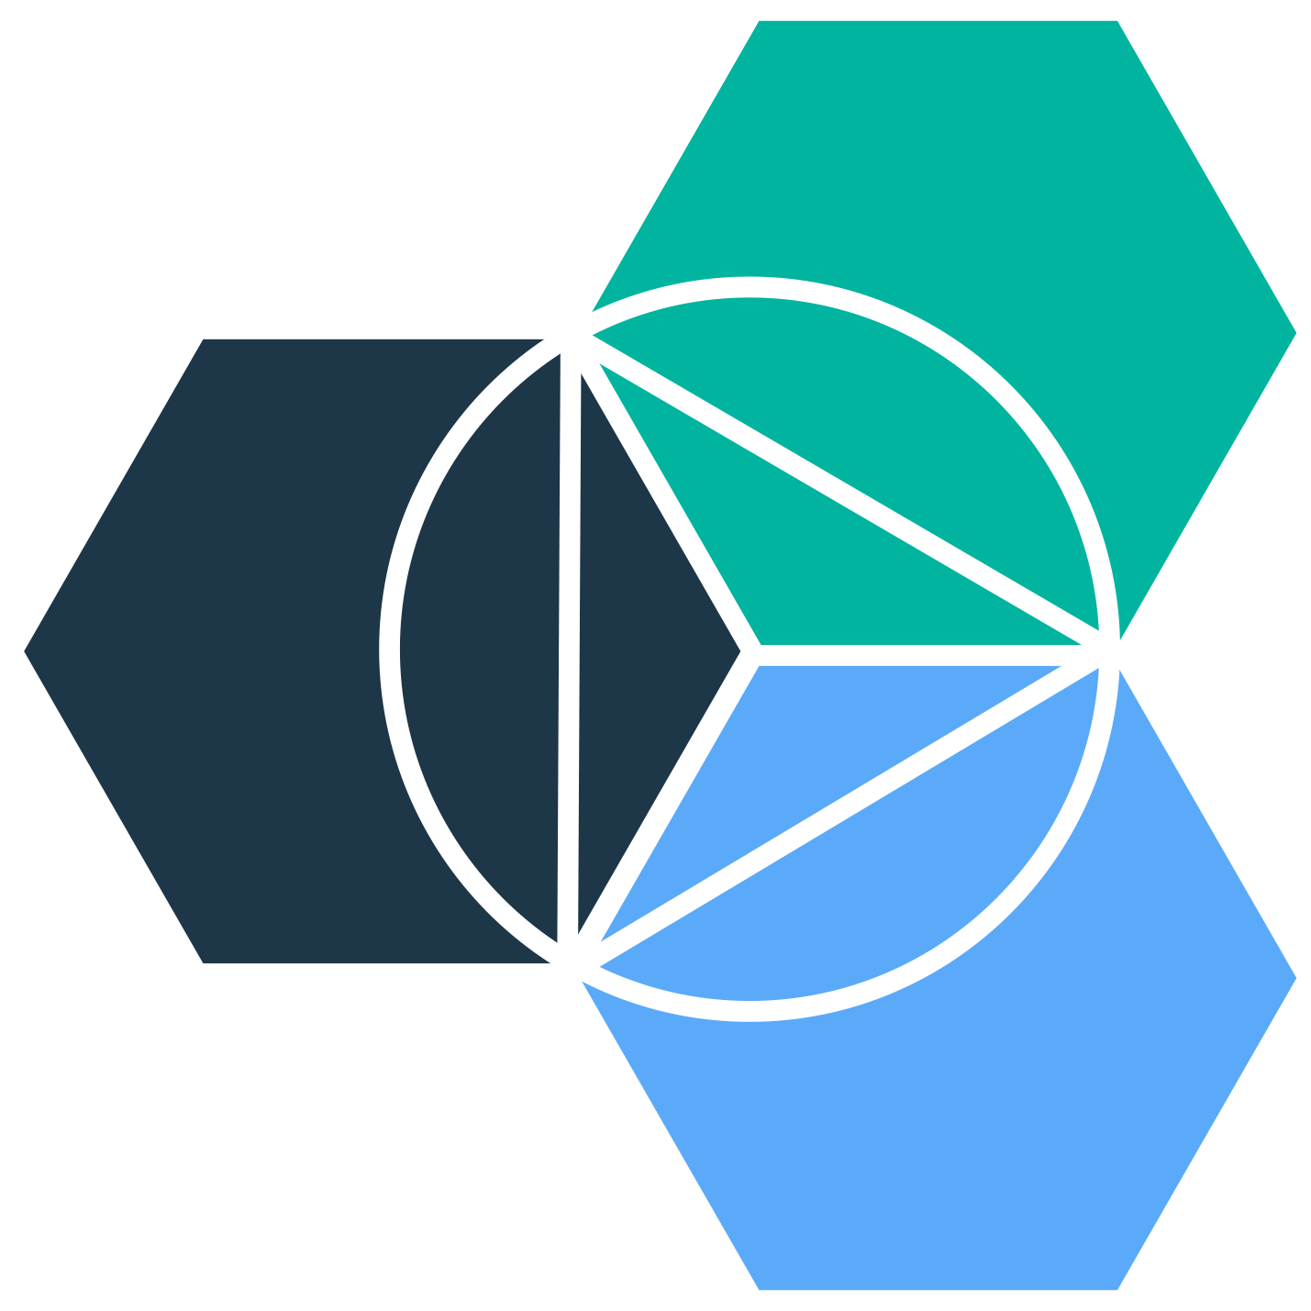





IBM Bluemix
THANK YOU
QUESTIONS?

